Slide 1
L1 Regularization Technique: Introduce regularization methods Lasso regression for logistic regression models
Khan Md Shibli Nomani
Email: kmshiblinomanii@gmail.com
WhatsApp: +8801672403057

Slide 2
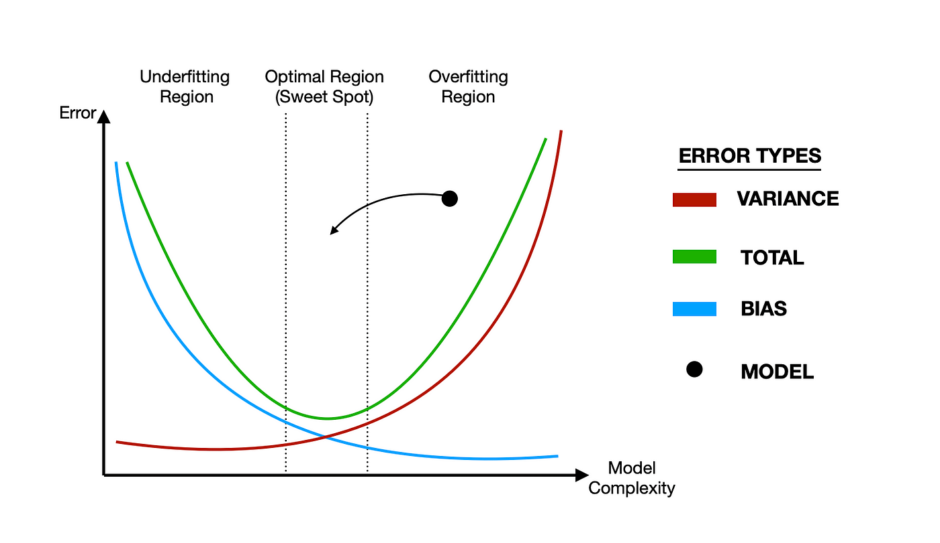
Regularization in machine learning is a technique used to prevent overfitting by adding a penalty term to the model's loss function, discouraging overly complex models. It helps in improving generalization by balancing model complexity and performance 🎯, reducing the risk of memorizing noise in the training data 🧹, and enhancing the model's ability to make accurate predictions on unseen data 🚀.
REGULARIZATION

Slide 3

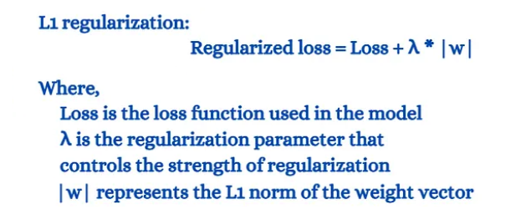
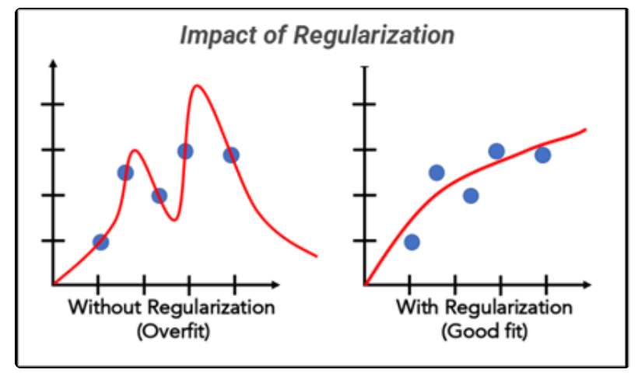
L1 regularization, like Lasso regression 🏋️‍♂️ for logistic regression models(Binary Classification), penalizes large coefficients by adding a term proportional to their absolute values to the loss function. This encourages sparsity 🕸️ in the model, effectively selecting only the most relevant features and reducing overfitting 🎯. By striking a balance between model complexity and predictive performance 🧩, L1 regularization ensures that the model generalizes well to unseen data while remaining interpretable 📊.
L1-REGULARIZATION

Slide 4
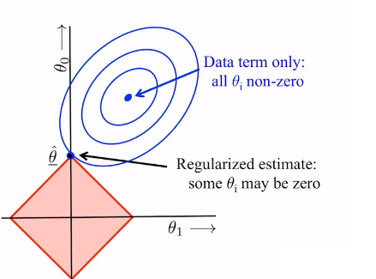
Utilizing L1 regularization, like Lasso logistic regression 🎯, on a model predicting customer churn 🔄, encourages feature selection 🧮 by zeroing out less impactful coefficients, such as infrequently purchased products 🛒. This results in a streamlined and interpretable model 📊, improving predictive accuracy while avoiding overfitting.
L1-REGULARIZATION

Slide 5
Thanks For You Time
Khan Md Shibli Nomani
WhatsApp: +8801672403057

